Slide 1


Finance & Risk Analysis
Capstone Project
By Rishikesh Patil

Slide 2



Objective
Analyze a portfolio of stocks to provide consultation to two different investors, Mr. Patrick Jyenger and Mr. Peter Jyenger based on their requirements and financial goals.
Advise Mr. Patrick Jyengar on constructing a stock portfolio aligned with his risk tolerance, aiming to double his $500,000 investment in five years for acquiring a minority stake in Naturo.
Recommend a high-risk stock selection to Mr. Peter Jyengar, considering his risk appetite, to achieve substantial returns on his $1 million investment within a five-year timeframe for the expansion of JWW.

Slide 3
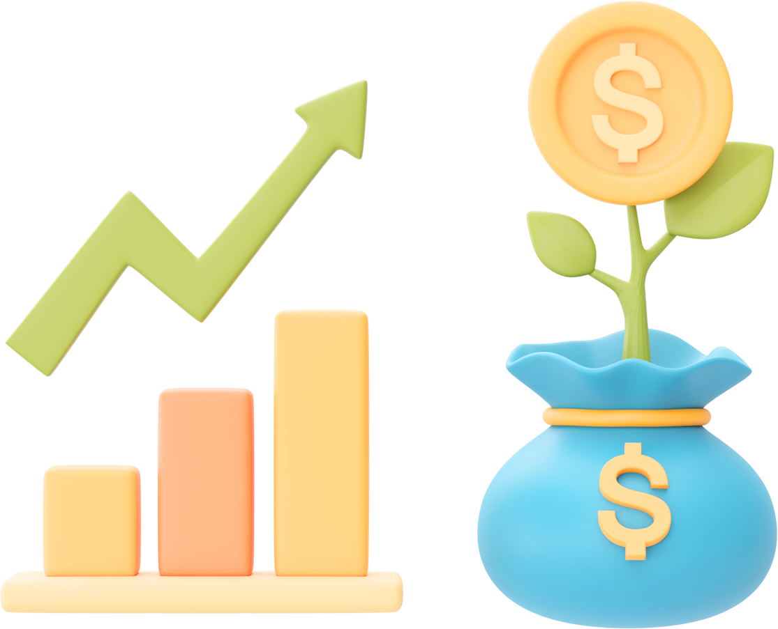

Data Description
We were provided with the following information for 24 stocks of leading companies listed on the New York Stock Exchange(NYSE):
Date
Open price: Price of stock at the start of the day
Close price: Price of stock at the end of the day
High price: Highest price reached by the stock on that day
Low price: Lowest price reached by the stock on that day
Adjusted close price: Stock price adjusted to include the annual returns (dividends) that the company offers to the shareholders
Volume traded: Number of stocks traded on the day
The information for every stock ranges from 1st October 2010 to 30th September 2020.
The stocks belong to different domains:
Technology/IT
Travel/Aviation/Hospitality
Banking/Financial Services and Insurance
Pharmaceuticals/Healthcare/Life Sciences
To help us with the market benchmark, we were given the S&P 500 index prices for the same period.

Slide 4

Methodology
Data Cleaning and Inspecting
Checked the dataset for any missing values and confirmed that no columns have null entries
Data Visualization
Created a variety of visual representations, such as bar charts, line charts, and correlation matrices, to help me better understand the dataset. Also used Power BI to create more attractive visualizations
Data Analysis
Performed Sector analysis to understand the impact of the pandemic on each sector.
Stock data was analyzed using various calculations, including annualized returns, risk, cumulative returns, Sharpe ratio, and return on investment (ROI).
Portfolio Building
After analyzing all the calculations, I built two customized stock portfolios and made sure that they satisfied the preferences and risk appetite of both clients.

Slide 5



Sectorial Analysis

Slide 6

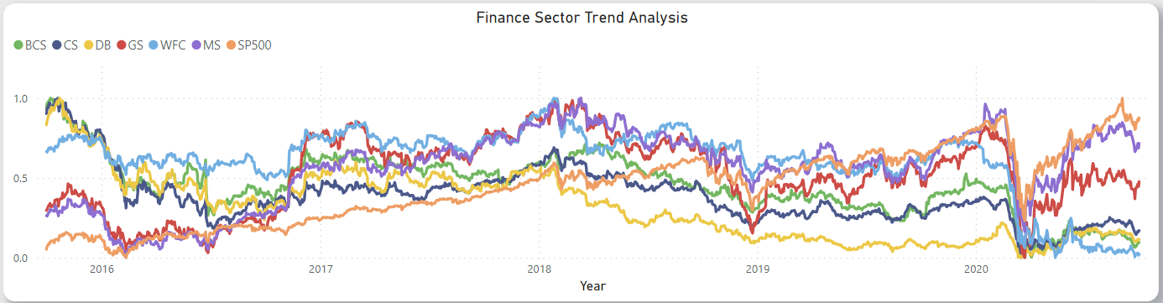

Finance Sector
The finance sector experienced a crisis in March 2020 because of the COVID-19 pandemic. Although many stocks in the sector were adversely affected, there has been a partial recovery. Notably, Morgan Stanley and Goldman Sachs have demonstrated better performance compared to other stocks.
Item Number 3

Slide 7
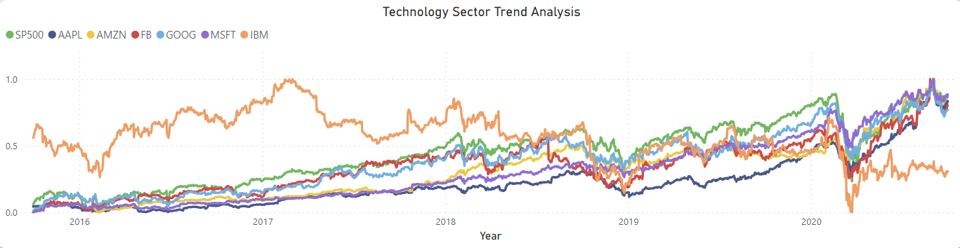
Technology Sector
The Technology Sector, like many other industries, faced a crisis in March 2020 amid the Covid Pandemic; however, its recovery has been noteworthy. Companies like Microsoft, Amazon, Apple, Facebook, and Google demonstrated robust performance, aligning with the overall market index. In contrast, IBM has consistently underperformed compared to its sector peers over the years.

Slide 8
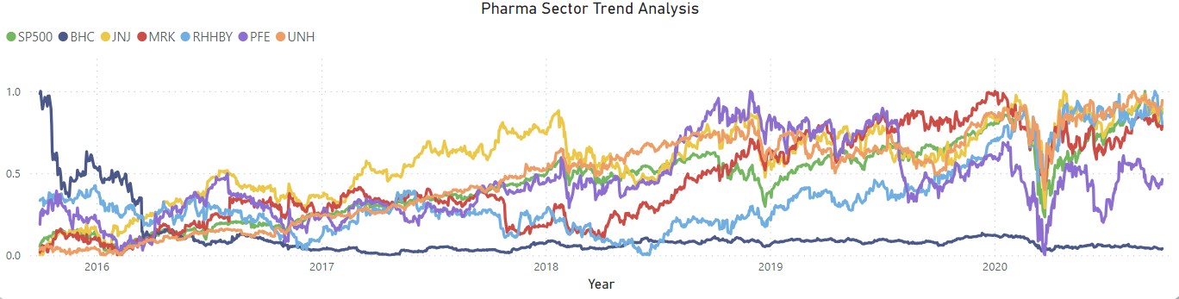
Pharma Sector
Despite the COVID-19 pandemic in March 2020, The pharmaceutical and healthcare sector has demonstrated impressive recovery, particularly with the increasing health consciousness among people. However, Bausch Health's performance has been consistently poor compared to other stocks in the sector.

Slide 9
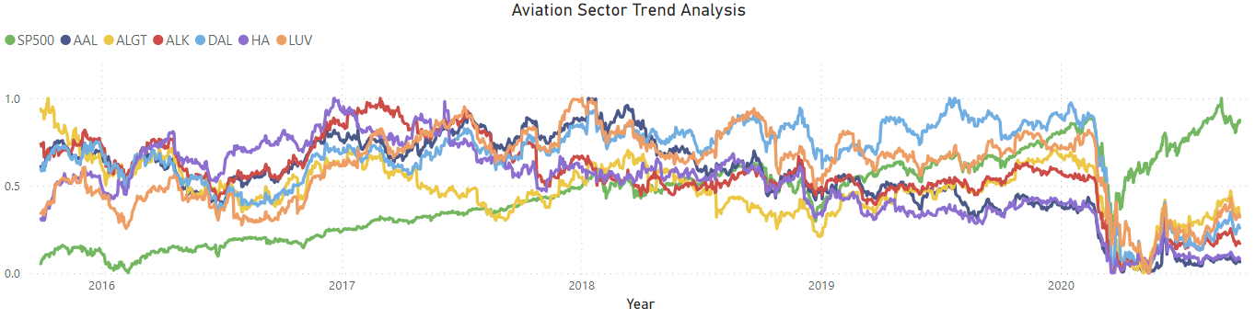
Aviation Sector
The COVID-19 pandemic had a devastating impact on the
aviation sector and despite the subsequent rise in the market index, it has
struggled to recover since then primarily because individuals remain hesitant
to engage in travel activities.

Slide 10

Portfolio Analysis

Slide 11
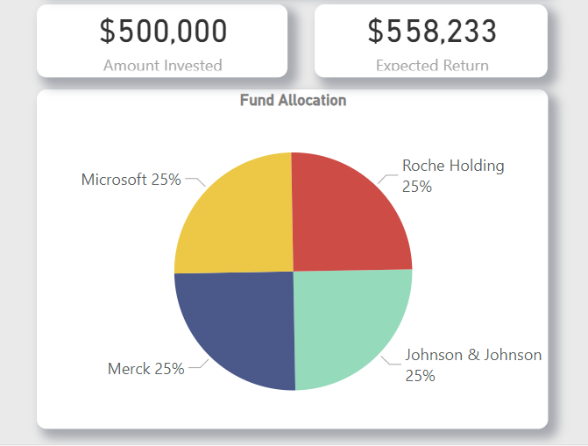
Mr. Patrick’s Portfolio
Mr. Patrick Jyenger, a conservative investor seeking low-risk options with decent returns, aims to double his capital in the next 5 years.
Considering his risk tolerance, we've identified three low-risk stocks—Johnson & Johnson, Roche Holding AG, and Merck & Co. Inc.
However, due to their modest returns, we modified our portfolio by allocating funds to Microsoft, a higher-return investment.
This strategy aims to enhance portfolio diversification and overall returns.

Slide 12
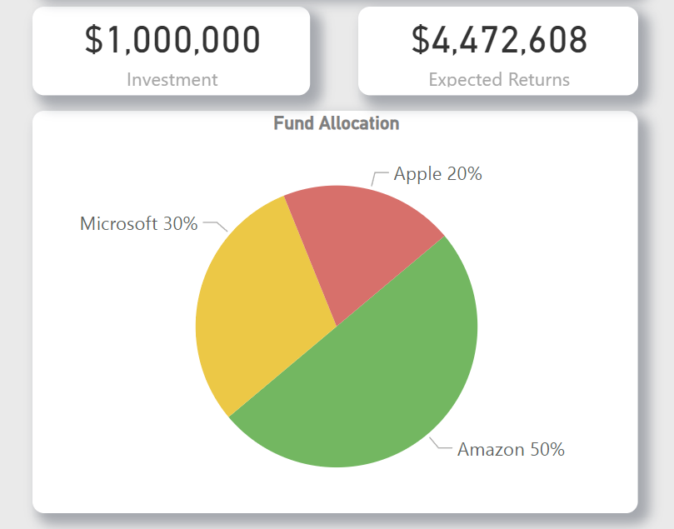
Mr. Peter’s Portfolio
Peter Jyengar prefers high-return investments, even if they are risky. He believes that he can recover from occasional losses.
He plans to invest $1 million from the company's cash reserves to expand the company organically within the next 5 years.
Given his risk appetite, high-risk/high-return stocks such as Amazon, Apple, and Microsoft will be suitable choices.
This aggressive investment strategy prioritizes maximizing returns as the primary objective.

Slide 13

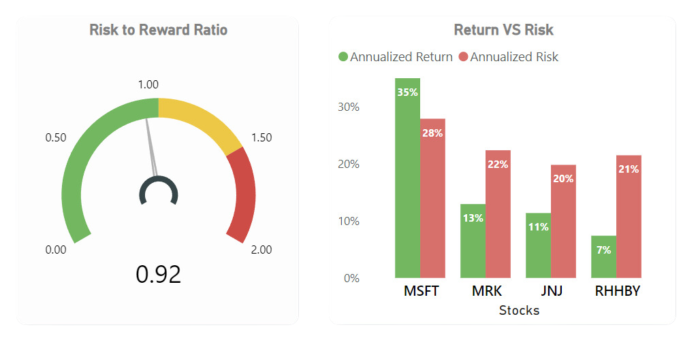
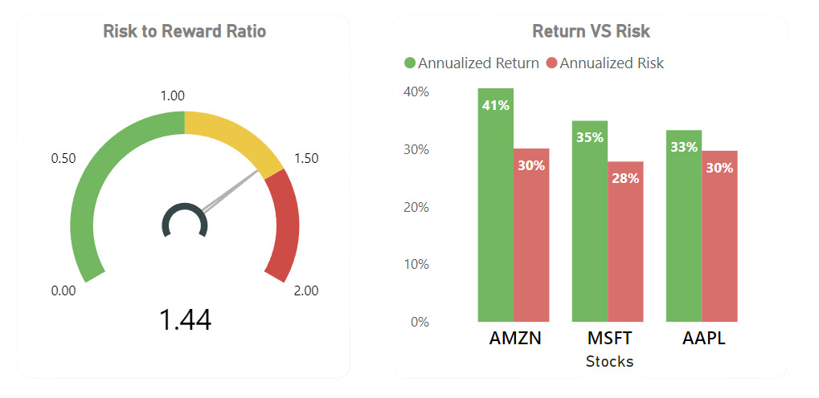
Risk Analysis
Mr. Patrick’s Risk Analysis
A Sharpe ratio between 0 and 1 indicates a reasonable balance between return and risk. It signifies that Mr. Patrick’s investment provides a reasonable return for the level of risk taken.
Mr. Peter’s Risk Analysis
A Sharpe ratio above 1 suggests that the investment is delivering returns above the risk-free rate and may be suitable for investors willing to take on a higher level of risk for potentially higher rewards.

Slide 14
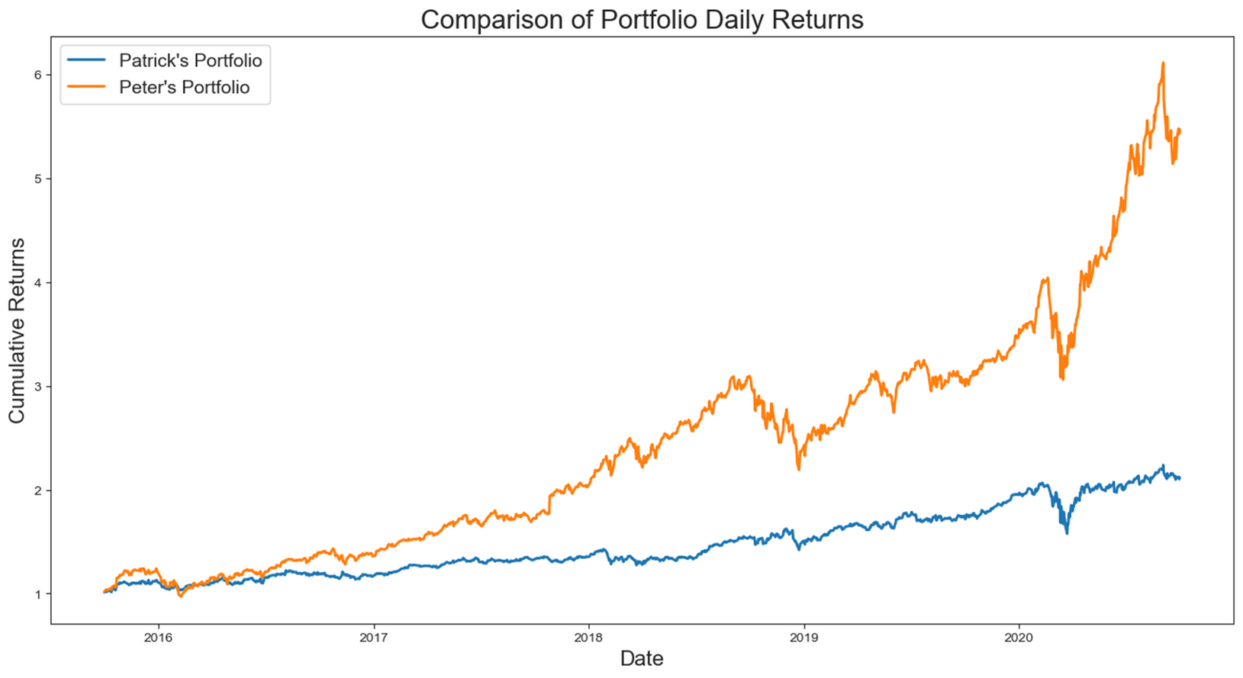
Conclusion
The charts indicate that both portfolios are following an upward trend, and if conditions remain favorable, they have the potential to meet our expected returns.
After analyzing the performance trends of both portfolios, Mr. Patrick's portfolio demonstrates slightly lower but more consistent and stable returns, even amid the challenges posed by the COVID-19
However, Mr. Peter's portfolio experienced a significant decline during this period, yet it swiftly recovered, generating impressive returns.

Slide 15

Thank You
For Your Time

